Slide 1
Coastline CRUD
Kate Spitzer, Sanabu Washizuka, Jonathan Hicks

Slide 2
Background
Analyzing Beach Information and Water Quality Data in California:
Audience:
People who want a more user-friendly way of picking beaches which fit their desires.
People who want to visit beaches that have better water quality.
People reviewing water quality testing standards and frequency.
Purpose:
Providing cleaned data on beaches so viewers can see all the information about any beaches they might want to visit in a fast and efficient manner.
Updates:
Current grade data will be scraped every day to update the current grade map for those who want to see beaches with the best water quality.
Importance:
Communicates public safety information.

Slide 3
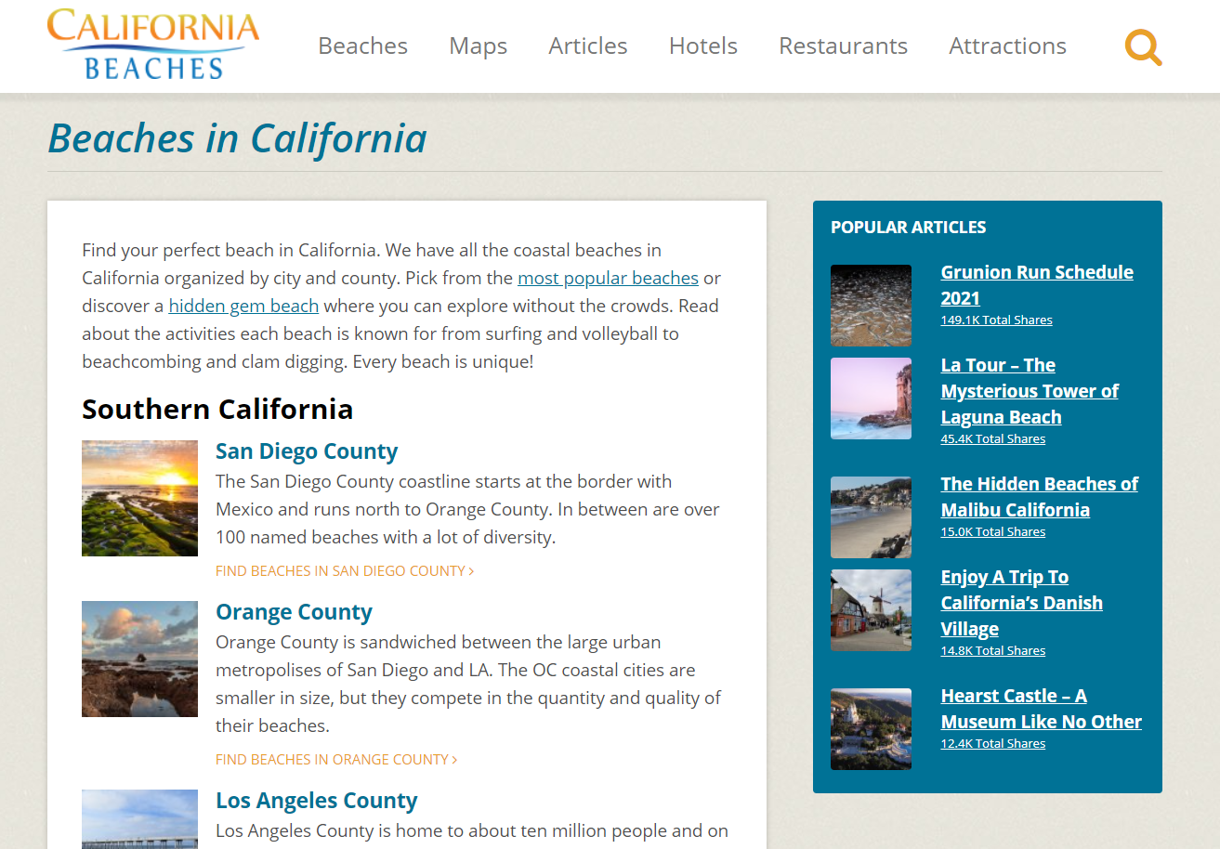
Californiabeaches.com - Site for Beach Information

Slide 4
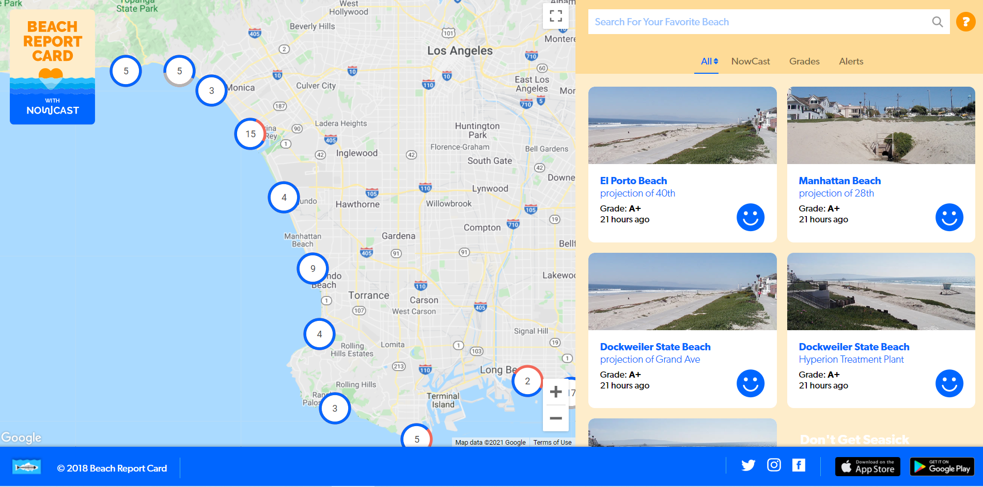
Beachreport.org - Site for Grade Data

Slide 5
Water Quality
Indicates the quality of water based on a states water quality standards.
Beach Report uses A-F grading system.
As the beach grade increases, risk of getting sick from water contact at that beach decreases.

Slide 6
WET GRADE
VS.
DRY GRADE
WET GRADE
DRY GRADE
Water sample taken while it is raining. Rain may affect the water quality.
Water sample taken during dry conditions.

Slide 7
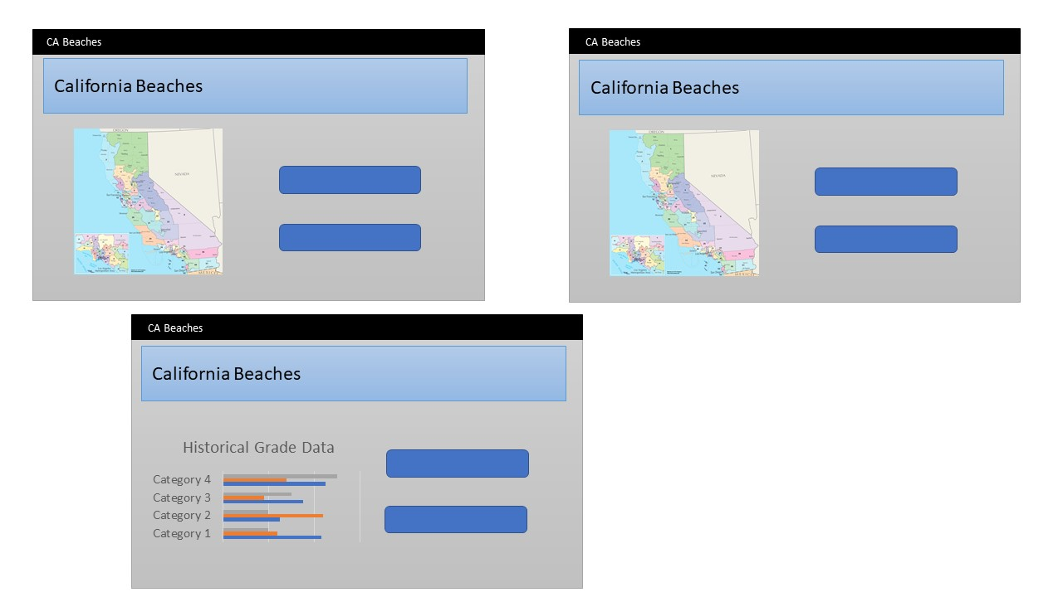
Sketch of Final Design
1.
3.
(beach info map)
(historical grade timeline map)
2.
(current grade map)
(historical stacked bar)

Slide 8
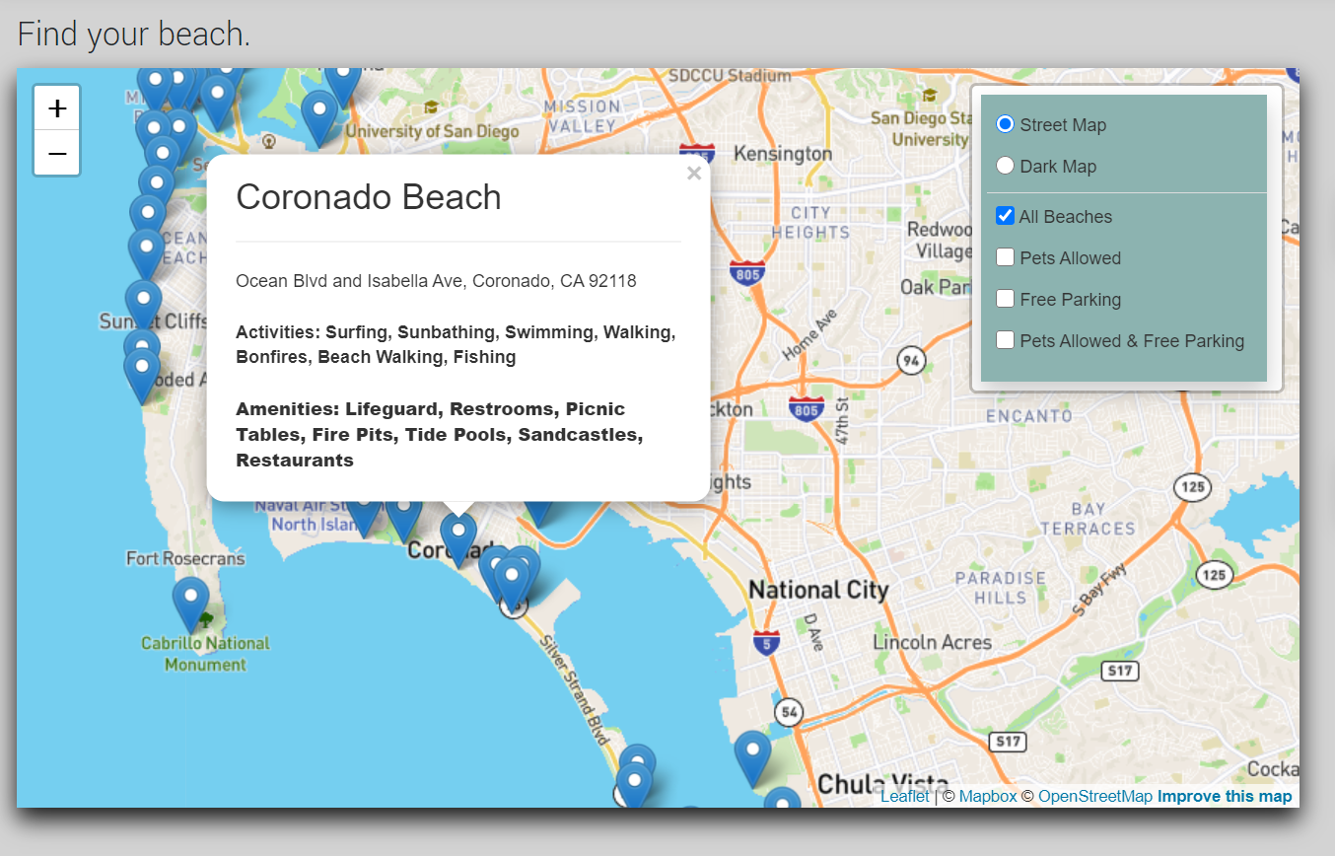
Leaflet: Beach Info Map
All beaches
All beaches pop up on the landing page.
Pop-ups
Beach name, address, activities, amenities.
Layer Controls
Beaches, pets allowed, free parking, pets allowed + free parking

Slide 9
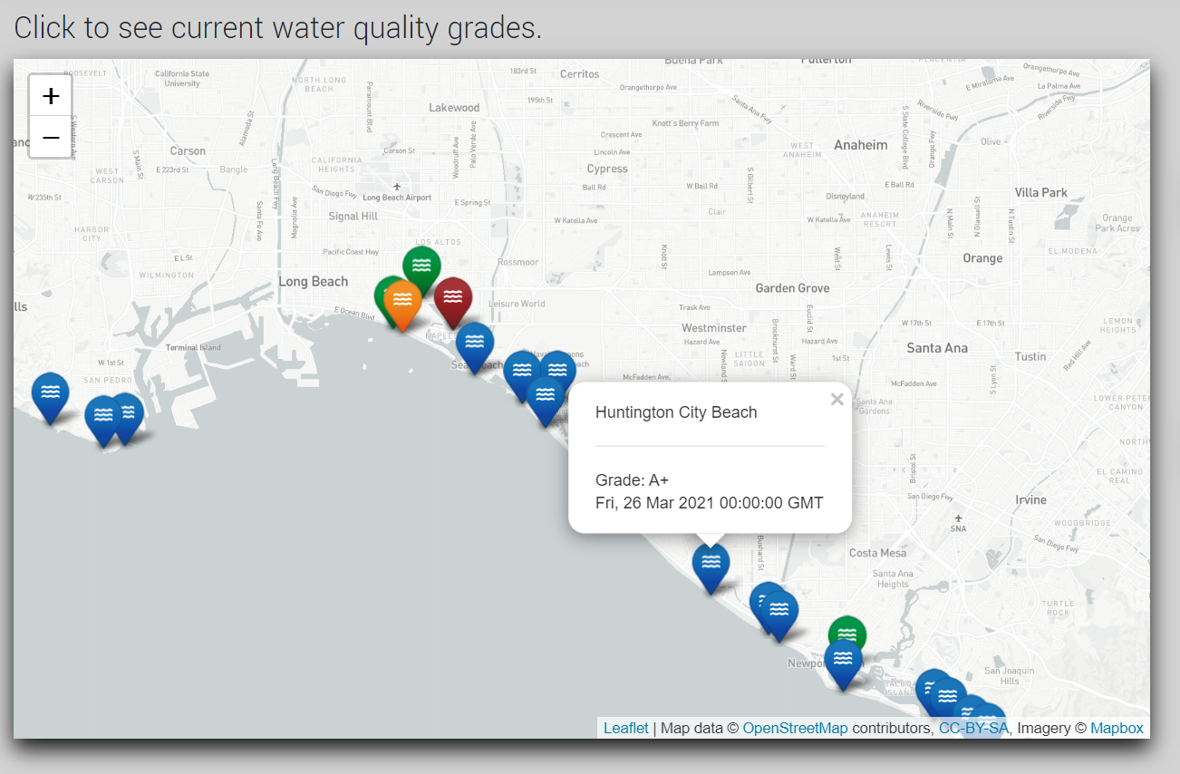
Leaflet: Current Grades Map
Markers
Displays the latest dry grade for all beaches with a valid record
Colors
Colors correspond to grades as: A - F -> Blue, Green, Yellow, Orange, Red
Pop-ups
Displays beach name, datetime of grade updated, and letter grade

Slide 10
Leaflet: Current Grades Map
Use Cases:
Beachgoers wondering how clean a particular beach is before visiting
Findings:
Most beaches have positive water quality grades
Improvements:
Provide a different color for grades of "ns" ("no sample") to distinguish from low grades

Slide 11
Leaflet-timeline: Map of water quality grades over time
Data points
All dry grades recorded, displaying at the time of recording and controlled by a scrollbar representing time.
Pop-ups
Markers can be interacted with, displaying a beach name.

Slide 12
Leaflet-timeline: Map of water quality grades over time
Use Cases:
Beachgoers wondering how consistently clean the water is at a beach
Compliance/consistency check for organizations conducting the sampling
Findings:
Data found to have inconsistent sampling across time
Improvements:
Provide a legend informing what colors reflect which grade values

Slide 13
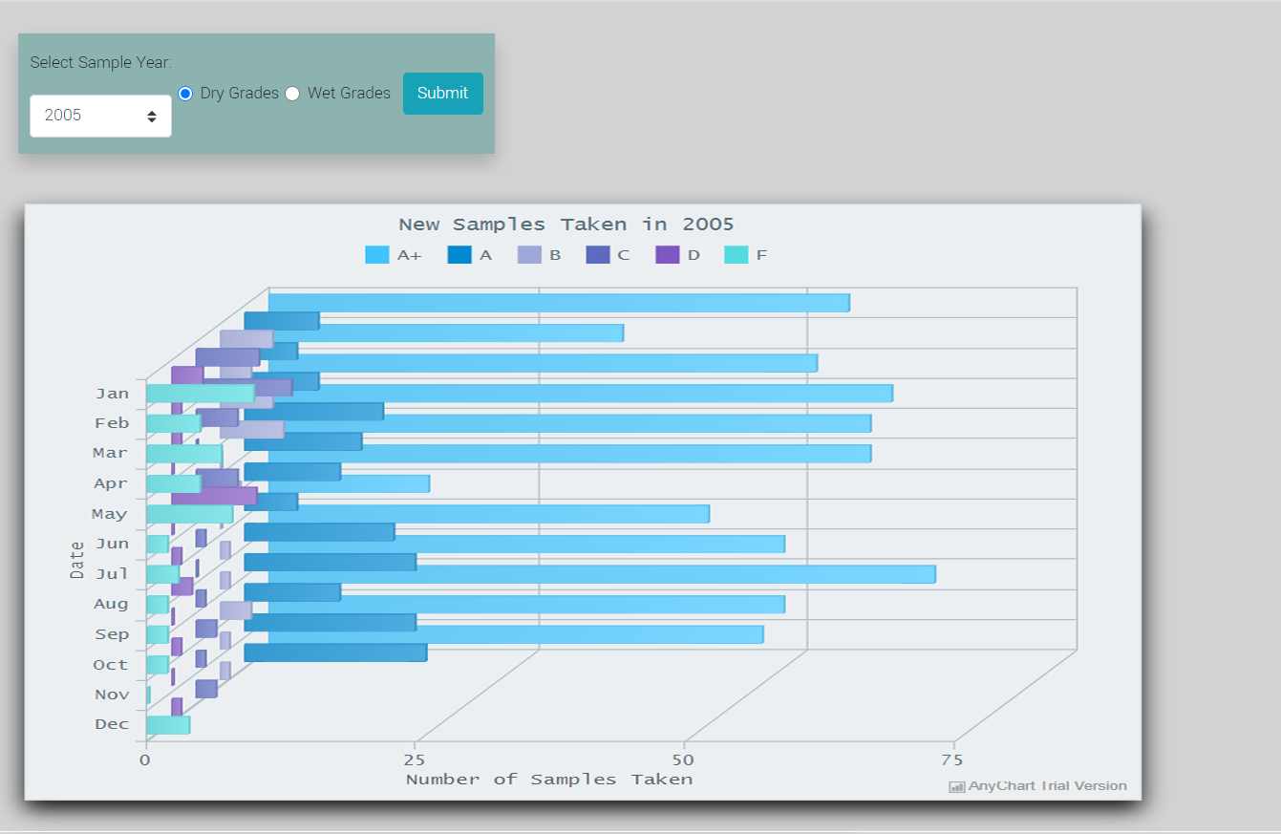
AnyChart: Historical Grade Stacked Bar Chart
Historical Data
Contains all historical data and their grades taken each year starting from 2005.
Drop-down
Allows you to select the year of interest.
Dry vs. Wet Grade
Focus in on either grade of choice.

Slide 14
Any Chart 3D Bar Chart: Comparison of when and how often water samples have been taken, historically
Use Cases:
Beachgoers wondering how often samples are taken and how current the data is kept
Sampling process owners could use to identify areas of improvement in sampling
Findings:
Data found to have inconsistent sampling across time
Improvements:
Indicate wet/dry grade data in chart title

Slide 15
Interesting Findings
48% of beaches allow pets.
47.7% have free parking.
26.4% allow pets + free parking.

Slide 16
Random Facts
16/120 beaches in San Diego County have trails! Enjoy a hike on the coast.
80% of beaches with fire pits are located in Southern California.
43% of beaches have bathrooms.
Less than 1% of beaches have a pier.

Slide 17
Final Conclusions
Going Forward
Hopefully people can find use of this application.
Adding more to the application as time goes on.
More layer controls, better group selections.
Improved web interface and layout.
Limitations Faced
Inconsistency with historical grade data.
Several wet grades missing due to sunny weather.
Layer groups misconstrued if more than one selected.
App could have been far more powerful/useful if datasets
were better correlated.

Slide 18
THANKS!
Does anyone have any questions?
Please keep this slide for attribution.

